Slide 1
Computer Network
Introduction

Slide 2
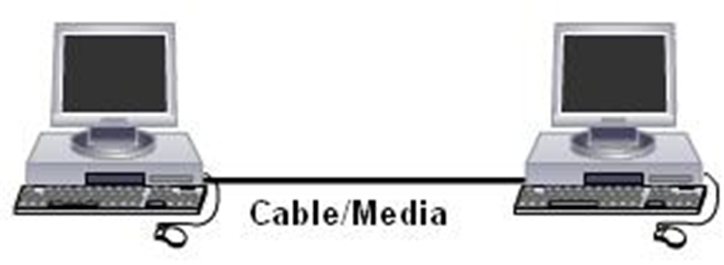
What is Networking?
Connections between two or more computers or devices with each other through any transmission media for the purpose of sharing information, application program and resources is called “network” and this process is called “networking”.
“Collection of two or more than two computers or devices is called network.”
“Sharing of resources between two or more than two computers or devices is called networking.”

Slide 3
Advantages of Network
Speed: sharing and transferring files within networks are very rapid.
Cost: shared programs, on a network allows for easier upgrading of the program on one single file server, instead of upgrading individual workstations.
Security: Sensitive files and programs on a network are passwords protected.
Resource sharing: Resources such as, printers, fax machines and modems can be shared.
Centralized software management.

Slide 4
Disadvantages of Network
Server faults stop applications being available
Network faults can cause loss of data.
Network fault could lead to loss of resources
User work dependent upon network
System open to hackers
Decisions tend to become centralised
Resources could be located too far from users
Difficult to manage large network

Slide 5
Requirements to Data communication
Sender
Receiver
Media
Guided media (wired)
Unguided media (wireless)
Message
Protocol

